Slide 1
Transmission Parameters
Notes:
Let’s being a discussion on another small module called ‘Transmission Parameters’…

Slide 2
Objectives
At the end of this session, you will be able to:
  Understand different transmission parameters and their impact on communication
  Understand the definition of bandwidth and comparison of bandwidth of different communication media
  Understand transmission parameters called attenuation
  Understand various forms of noise in communication, their impact on transmission, measurement of SNR and remedy if any

Slide 3
Agenda
Transmission parameters and their impact on communication
Bandwidth
Attenuation
Noise
SNR

Slide 4
Transmission Parameters
Bandwidth
Attenuation
Noise
Crosstalk
External interference
Notes:
There are different transmission line parameters that affect the transmission of a signal…
Out of which no.1 bandwidth of transmission medium can affect ..
No.2. attenuation of a signal when a signal traverses through transmission medium
No.3 noise …4 cross talk and the last one is external interference…
So let’s have a look at one by one…

Slide 5
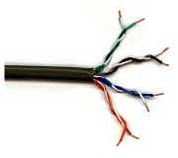
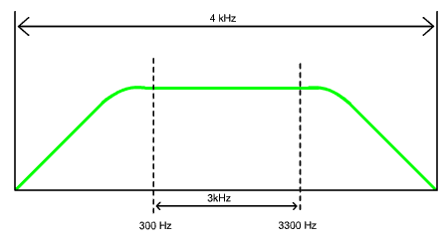
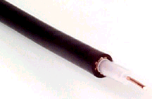
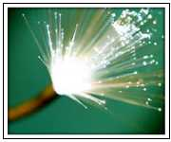
Bandwidth
Range of frequencies that can be carried across a given
transmission channel
Notes:
Bandwidth… bandwidth of communicaiton channel is nothing but range of frequencies that can be carried across a given transmission channel
So with this , every tranmission medium has some limit on highest frequency components that can be passed through without any distortion…
None of the communication medium has got infinite bandwidth..Shown towards the left side of the figure is a picture depicting increase in the bandwidth as you go from twisted pair to fiber…Technically bandwidth is nothing but highest frequency component – lowest frequency component. Assuming that lowest frequency component to be zero, bandwidth of communication channel is equal to highest frequency component…
Shown on the right side a typical human voice bandwidth i.e. what human can speak….having maximum frequency component of 4Khz so we say bandwidth of human voice as 4 KHz in the idel condition. However, real usable bandwidth of human voice is from 300Hz to 3300 Hz i.e. 3 KHz…Even air as communication medium has got such a bandwidth that it can transmit extreme low to extreme high frequencies. Radio , TV and satellite communication uses air as a communication channel….Optical fiber can transmit signals in Terahertz range…
So in nut shell bandwidth of such communication media is so high that to utilize it to an optimism extent , we always send multiple signals through the same medium by using a technique called multiplexing which we will see soon…

Slide 6
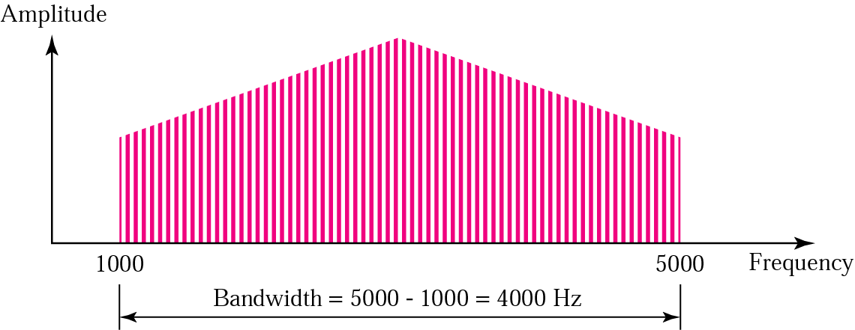
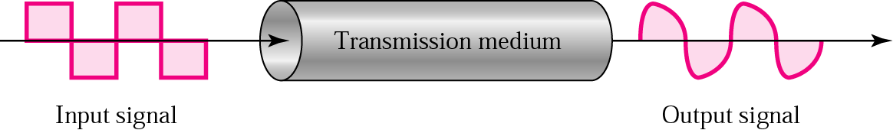
Bandwidth and its Impact on Transmission
Transmission Medium Signal Corruption
Notes:
This is another example of bandwidth…Highest freq. component is 5000 and lowest one is 1000 , so bandwidth is 5000-1000 which is equal to 4000…
By the way, shown below is a digital signal square wave being passed thorough transmission medium which gets distorted when passed through because digital signal can be though of as sum of infinite collection of sine and cosine waves of different frequency , amplitude and phase. This is a basis for fourier series which was explained by a scientist called fourier. And none of the communication medium has infinite bandwidth so that they can pass on digital signal as it is…And that is presizely what has happened above….few of high frequency components which could not get through the communication medium ,so they got lost and that is why the shape of the signal at the output side…Solution to this problem is given by a phenomenon called Modulation which we will see soon..

Slide 7


Attenuation
Attenuation
  Opposite of amplification
  Reduction of signal strength
  Signal becomes unintelligible
  Measured in decibels
digital signal regeneration
analog signal amplification
Notes:
Attenuation ..Attenuation manifests itself as a reduction of the signal's amplitude in the receiver. Attenuation is Opposite of amplification and it is something to do with reduction of signal strength…When you pass the signal through any transmission medium, because of the characteristics of the medium, signal strength gets reduced. This reduction factor depends on the type of communication medium. It is least in fiber optic and most in Air. Analogy…hitting a ball on the ground…ground offers resistance and slows down the speed of ball…If ground would have been resistance less then ball would have traversed infinitely…which is practically not possible…
Because of this phenomenon signal strength is reduced to such an extent that signal becomes unintelligible …so there is need of amplification…Shown on left side a typical amplification process and right below is the same one in digital context… Note that in CN context, this amplifier is called as repeater….By the way , amount of attenuation is always measures in decibels.
Here we should understand one thing that attenuation is in nobody’s hand… none of the transmission media are ideal …moreover transmission media are passive in nature..…so attenuation is a part of life…and repeater or amplifiers are required if we want to send signal towards much longer distance…

Slide 8
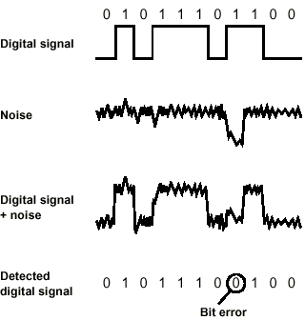
Noise - Bit Error
Notes:
Another factor affecting transmission is noise…so let’s try to understand this attribute
Also it is worth to mention that communucation media being passive and non-intellegent, can not differentiate between noise and a signal…so it is not the duty of communication medium to resist the noise… It is duty of end equipments and protocols embeded therein to make sure that WHAT IS SENT IS WHAT IS RECEIVED. To tackle this, we must have error detection and error correction techniques built in at both end equipments or protocols…
Noise factor varies across the communication media ….In air it is maximum whereas in fiber optic it is minimum…but we cannot say, that the error can not happen…

Slide 9
Noise
External Noise
  Man-made noise
    Generated by equipment such as motors.
  Atmospheric noise (also called static)
    Dominates at lower frequencies .
  Space noise (Mostly solar noise)
    Dominates at higher frequencies and can be a serious problem in satellite communications.
Internal Noise
  Thermal noise (also called white noise)
    Is produced by random motion of electrons in a conductor due to heat.
    Noise Power in watts is directly proportional to Bandwidth in Hz, and the temperature in degrees Kelvin.
Notes:
Typical classification of noise called ‘External noise’ or Internal noise is shown in the figure…
Under external noise category we have ….so and so …. Which you can not eliminate …Radio TV really needs to take care of this…

Slide 10
Signal-to-Noise Ratio (SNR)
Signal-to-Noise Ratio (SNR)
  Ratio of signal power to noise power
  Is expressed in decibels
  SNR (dB) = 10 log10 (PS/PN)
  PS is the signal power in watts PN is the noise power in watts
Notes:
How to evaluate a communication system from a noise perspective ? So solution towards this is SNR…Signal to Noise ratio…. Communication system is said to be better if SNR is more…
Explain SNR eqn…
tell that Pn not in controll, so what you can control is Ps ..signal power. If we want more power, we need to have powerful amplifiers…

Slide 11
Example
Imagine a signal travels through an amplifier and its power is increased ten times. This means that P2 = 10 * P1. In this case, the amplification (gain of power) can be calculated as
10 log₁₀ (P2/P1) = 10 log₁₀ (10P1/P1)
= 10 log₁₀ (10) = 10 (1) = 10 dB

Slide 12
Summary
In this session, we have learned:
  Different transmission parameters and their impact on communication
  Definition of bandwidth and comparison of bandwidth of different communication media
  Transmission parameters such as attenuation, noise and their impact on transmission and remedy
  Definition and formula of SNR

Slide 13
Thank You

